Slide 1

Getting What We Deserve: Theologies at the Intersection of Disability and Work
Max Thornton
maxthornton3000@gmail.com

Slide 2

The Protestant Work Ethic
“[T]he religious valuation of restless, continuous, systematic work in a worldly calling, as the highest means to asceticism, and at the same time the surest and most evident proof of rebirth and genuine faith, must have been the most powerful conceivable lever for the expansion of that attitude toward life which we have here called the spirit of capitalism.”
Max Weber, The Protestant Ethic and the Spirit of Capitalism (trans. Talcott Parsons)

Slide 3
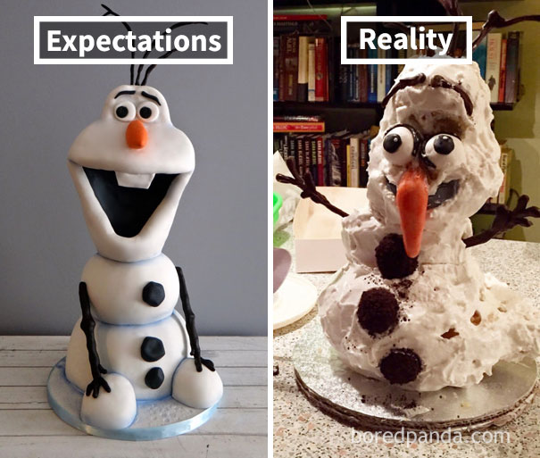

Slide 4

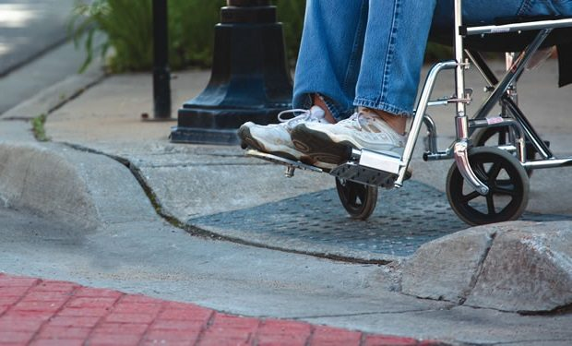
Solutions for Wheelchair Users
Medical model
Social model

Slide 5
ADA Definition of Disability
(1) Disability
The term “disability” means, with respect to an individual—
(A) a physical or mental impairment that substantially limits one or more major life activities of such individual;
(B) a record of such an impairment; or
(C) being regarded as having such an impairment (as described in paragraph (3)).
ADA Sec. 12102
(3) Regarded as having such an impairment
For purposes of paragraph (1)(C):
(A) An individual meets the requirement of “being regarded as having such an impairment” if the individual establishes that he or she has been subjected to an action prohibited under this chapter because of an actual or perceived physical or mental impairment whether or not the impairment limits or is perceived to limit a major life activity.
(B) Paragraph (1)(C) shall not apply to impairments that are transitory and minor. A transitory impairment is an impairment with an actual or expected duration of 6 months or less.

Slide 6
ADA Exclusions
While pregnancy is not a disability in and of itself under the ADA, some pregnancy-related conditions may be disabilities under the law.
Department of Labor website, https://www.dol.gov/agencies/wb/pregnancy
Under this chapter, the term “disability” shall not include
(1) transvestism, transsexualism, pedophilia, exhibitionism, voyeurism, gender identity disorders not resulting from physical impairments, or other sexual behavior disorders;
(2) compulsive gambling, kleptomania, or pyromania; or
(3) psychoactive substance use disorders resulting from current illegal use of drugs.
ADA Section 12211
For purposes of this chapter, the term “individual with a disability” does not include an individual who is currently engaging in the illegal use of drugs, when the covered entity acts on the basis of such use.
[Unless they are] an individual who
(1) has successfully completed a supervised drug rehabilitation program and is no longer engaging in the illegal use of drugs, or has otherwise been rehabilitated successfully and is no longer engaging in such use;
(2) is participating in a supervised rehabilitation program and is no longer engaging in such use; or
(3) is erroneously regarded as engaging in such use, but is not engaging in such use
ADA Section 12210

Slide 7

Poverty vs. Pauperism
“In speaking of poverty, let us never forget that there is a distinction between this and pauperism. The former is an unavoidable evil, to which many are brought through necessity, and in the wise and gracious providence of God. It is the result, not of our faults, but of our misfortunes . . . . Pauperism is the consequence of willful error, of shameful indolence, of vicious habits. It is a misery of human creation, the pernicious work of man, the lamentable consequence of bad principles and morals.”
Rev. Charles Burroughs, 1834

Slide 8


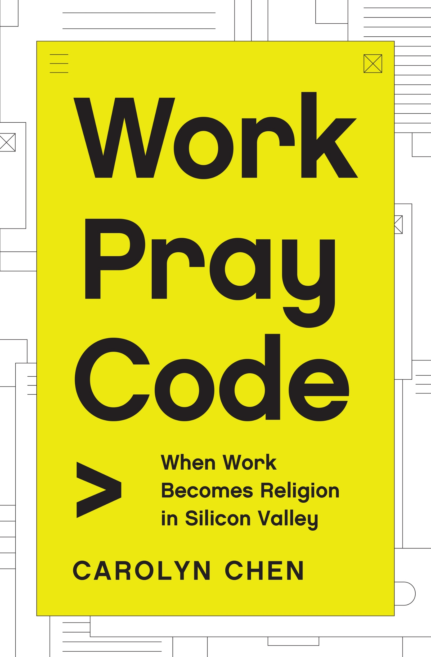

Slide 9
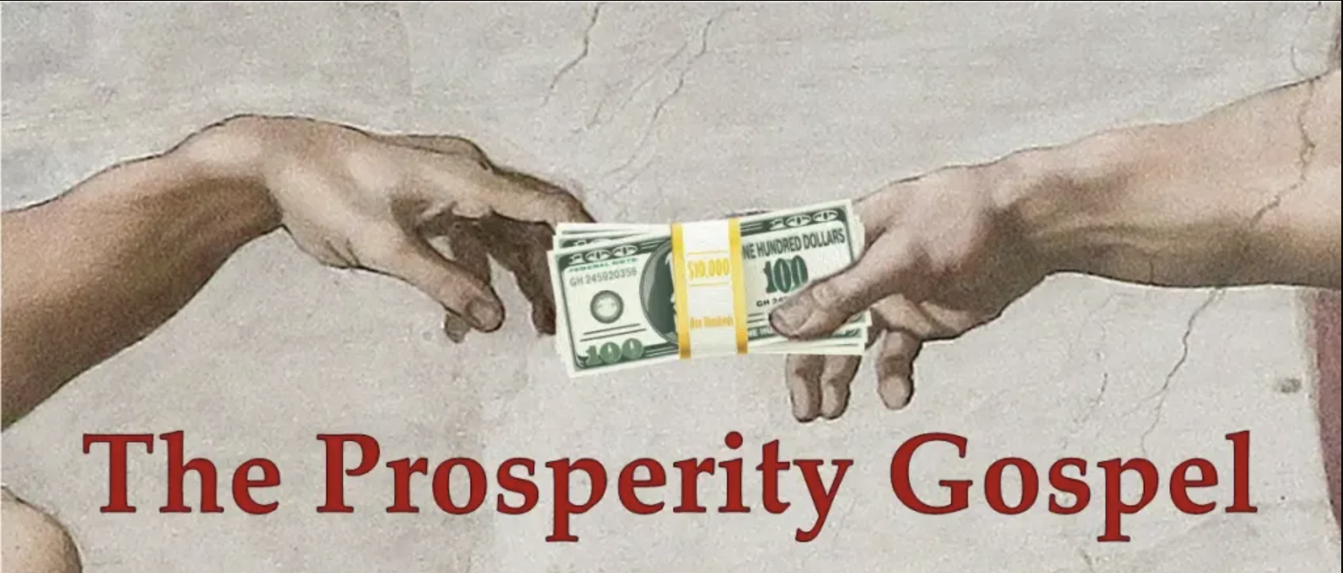

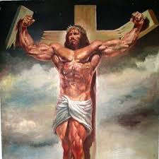



Slide 10

Artist: Emunah Woolf

